Slide 1





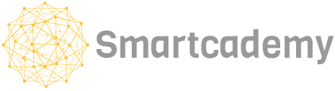
Suara Hati
The little voice in your heart to get you checked up!
pilid | Matheus Aaron
| Nadya Devani

Slide 2
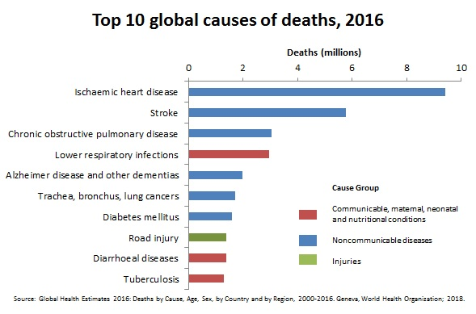
Cardiovascular diseases (“CVD”) are the #1 global cause of death in the world, including Indonesia.
Notes:
1. Penyakit Kardiovaskular
Kematian terbanyak di Indonesia disebabkan oleh penyakit kardiovaskuler. Ini adalah golongan berbagai penyakit yang terkait dengan gangguan fungsi jantung dan pembuluh darah seperti penyakit jantung koroner (PJK), gagal jantung, stroke, dan hipertensi. Data Riset Kesehatan Dasar Indonesia (Riskesdas) menunjukkan bahwa 42,3 persen kematian tahun 2013 disebabkan oleh PJK dan 38,3 persen disebabkan oleh stroke. Penyakit kardiovaskuler ini diperkirakan lebih banyak ditemukan pada perempuan dibanding laki-laki, tepatnya pada kelompok umur 44 - 45 tahun, 55 - 64 tahun dan 65 - 74 tahun. Maka dari itu kardiovaskuler merupakan salah satu penyakit penyebab kematian.

Slide 3
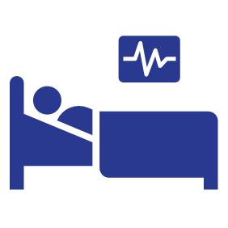
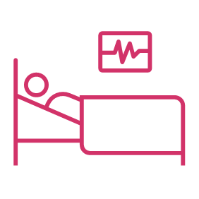
However, less than 25% primary health care centres offered CVD risk stratification.
World Health Organization, 2017

Slide 4


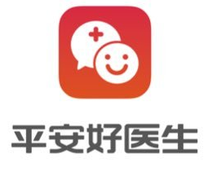


Now, there has been a rise in the number of telehealth services.

Slide 5


Despite the rise in telemedical platforms, many people are still out of reach from it.
In 2018, 1 in 3 Indonesians still does not have access to the Internet.
(Indonesian Internet Service Provider Association, 2018)

Slide 6
A wishful thinking...

Slide 7
Without proper CVD risk assessment in rural areas, it would be hard to diagnose potential CVD...

Slide 8
Consulting a doctor through telemedical platforms are not that easy and may take quite a while for them to respond...

Slide 9
If there is a better way for people to self-diagnose with potential cardiovascular diseases, people will be informed and will be less prone to cardiovascular diseases.

Slide 10
Problem Statement
How might we pre-diagnose a patient based on its self-description of its symptoms?

Slide 11
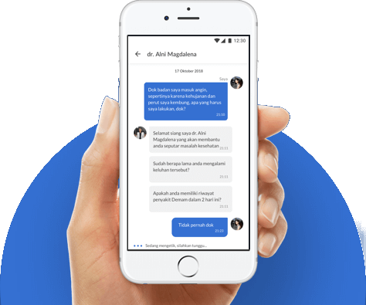
Dataset: Alodokter
Alodokter is a Indonesian healthcare superapp where users can post the queries with certified doctors regarding their complaints.

Slide 12
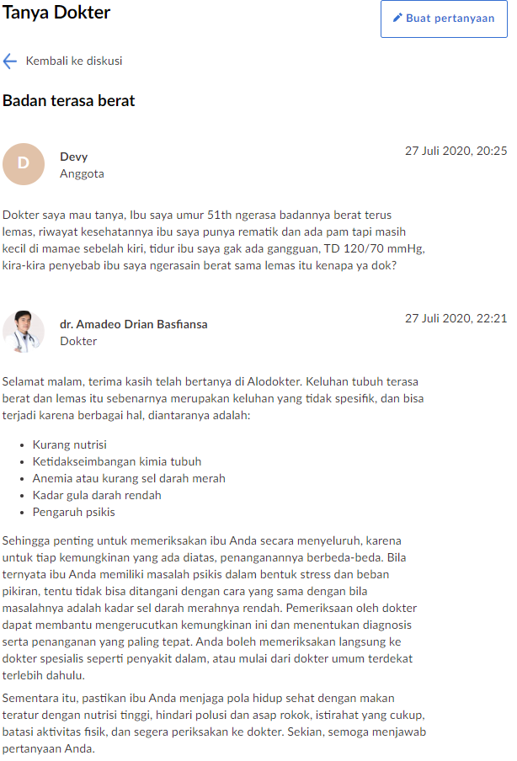
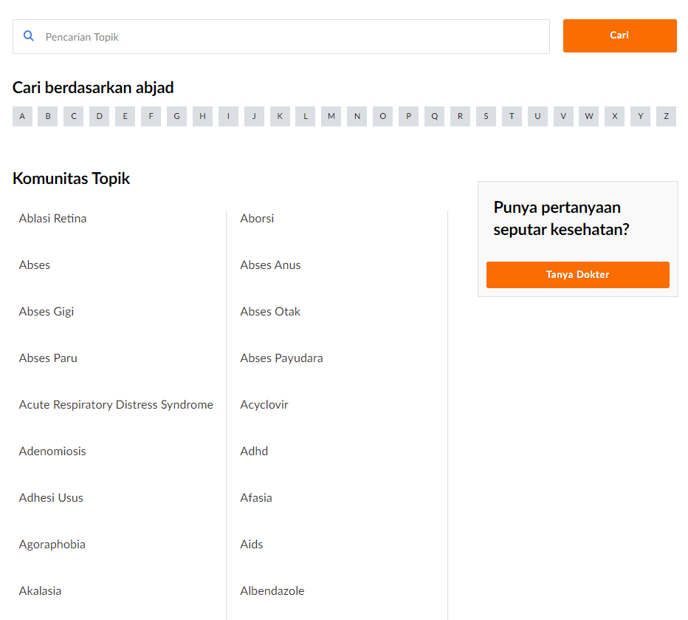
Komunitas Alodokter
Notes:
Komunitas Alodokter is a forum where users can post medical questions and will be answered by Alodokter’s verified doctors.
There are 1213 categories of posts. Categories include medical problems, drugs, and treatment.

Slide 13
Proposed Solution
Given the user complaint, predict the diagnosis.
The diagnosis here is the category of the post.
The scope of the project is limited to the following most 5 common cardiovascular diseases:
Indonesia | English
stroke | stroke
hipertensi / tekanan darah tinggi | hypertension / high blood pressure
gagal jantung | heart failure
aritmia | arrhythmia
serangan jantung | heart attack

Slide 14
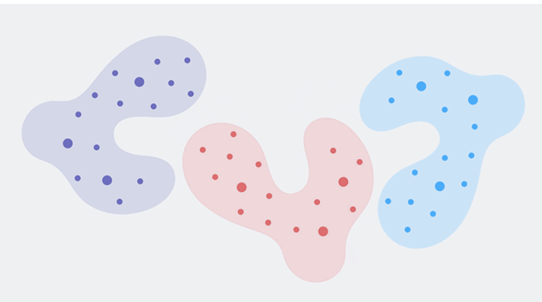
Proposed Model: BERT
Each dot is representing a word in a vector space.
The distance between words shows the relations.
Bidirectional
Encoder
Representations from
Transformers
New method of pre-training language representations using bidirectionality of Transformers

Slide 15
BERT-Base
For this project, we will use a pre-trained model provided by Google to save computational power.
It is trained on...
104 languages
12-layer
768-attributes
12-heads
110M parameters
Multilingual Cased

Slide 16



Why BERT?
Bidirectionality
It can understand the context of a sentence from the left and from the right. Bag of Words and TF-IDF does not encode context while other neural networks tend to be unidirectional (context is only provided from preceding words).
Transfer Learning
The model has been trained on huge corpus of data. It does not have to learn from zero from the training data alone. This has been observed in computer vision and currently being applied in natural language processing.
Fast
It is significantly faster compared to LSTM as it can process the tokens concurrently and does not have to wait from preceding tokens.

Slide 17
The project consists of three stages: data collection, feature engineering, and modelling.
Scrape data from Alodokter.com
Remove common words
Fine-tune BERT on training data and evaluate on test set
Using request, BeautifulSoup, and json, scrape user posts in each category.
Users love to use pleasantries.
For example:
Selamat pagi (Good Morning)
Halo dok (Hello, doc)
etc.
Remove these phrases as they add no valuable information.
Fine-tune BERT’s pretrained weights with the supervised training dataset.
Neural network does not need evaluation dataset as it will auto-finetune from its training dataset.

Slide 18
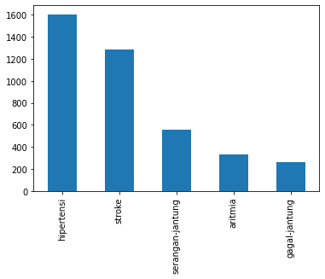
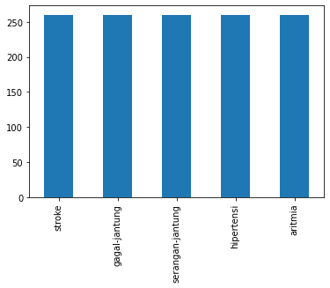
Dataset Profile
diagnosis | count | proportion
serangan-jantung | 436 | 30%
aritmia | 275 | 19%
stroke | 214 | 15%
gagal-jantung | 213 | 15%
penyakit-jantung-bawaan | 101 | 7%
penyakit-jantung-koroner | 87 | 6%
penyakit-katup-jantung | 86 | 6%
kardiomiopati | 20 | 1%
aterosklerosis | 14 | 1%
trombosis-vena-dalam | 4 | 0%
Grand Total | 1450 | 100%
Undersampling

Slide 19
Sample User Post
Dok, akhir" ini ketika saya menaiki tangga jantung saya berdebar keras hingga terasa tanpa dipegang dan tengkuk leher juga demikian, juga nafas terasa ngos"an. Gejala ya itu dok? Terima kasih
ARITMIA

Slide 20
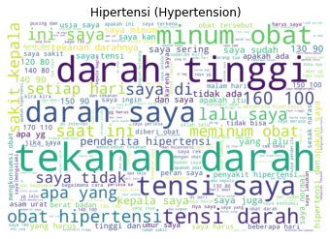
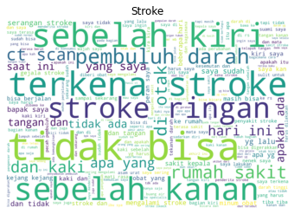
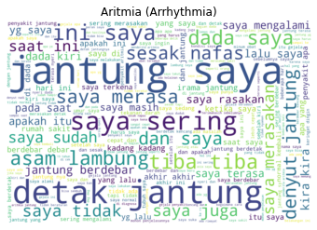
Here’s how users described their symptoms.

Slide 21
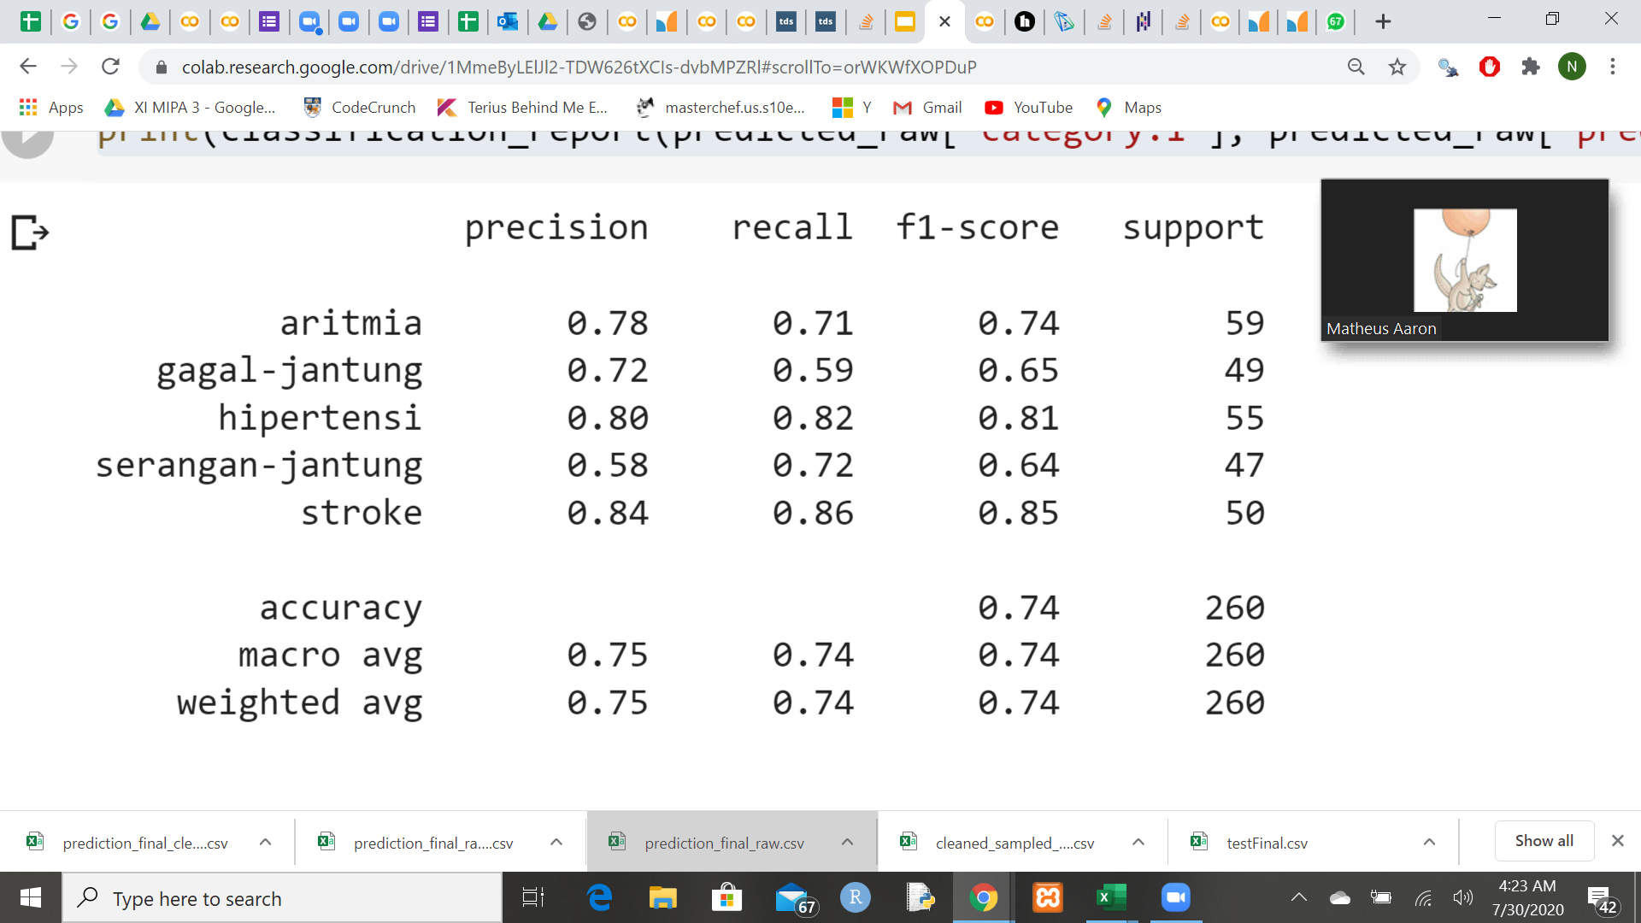
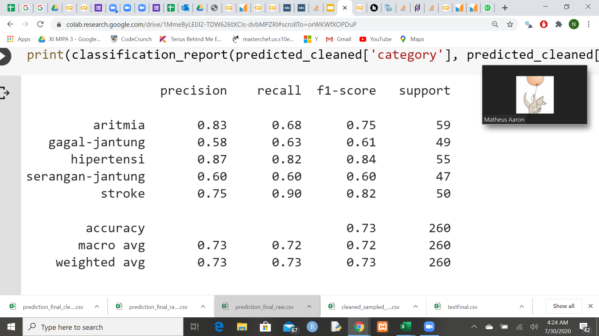
Model Performance
Before Data Cleaning After Data Cleaning
Notes:
Verbally:
classes are little and the classes are quite distinct, the model can tolerate the noise.
We empirically observed a increase in accuracy from around 40% to 60% when all 11 classes are included and data is cleaned.\
Hence, we still believe cleaning is an important step albeit not shown here in the sample 5-class classification model.

Slide 22
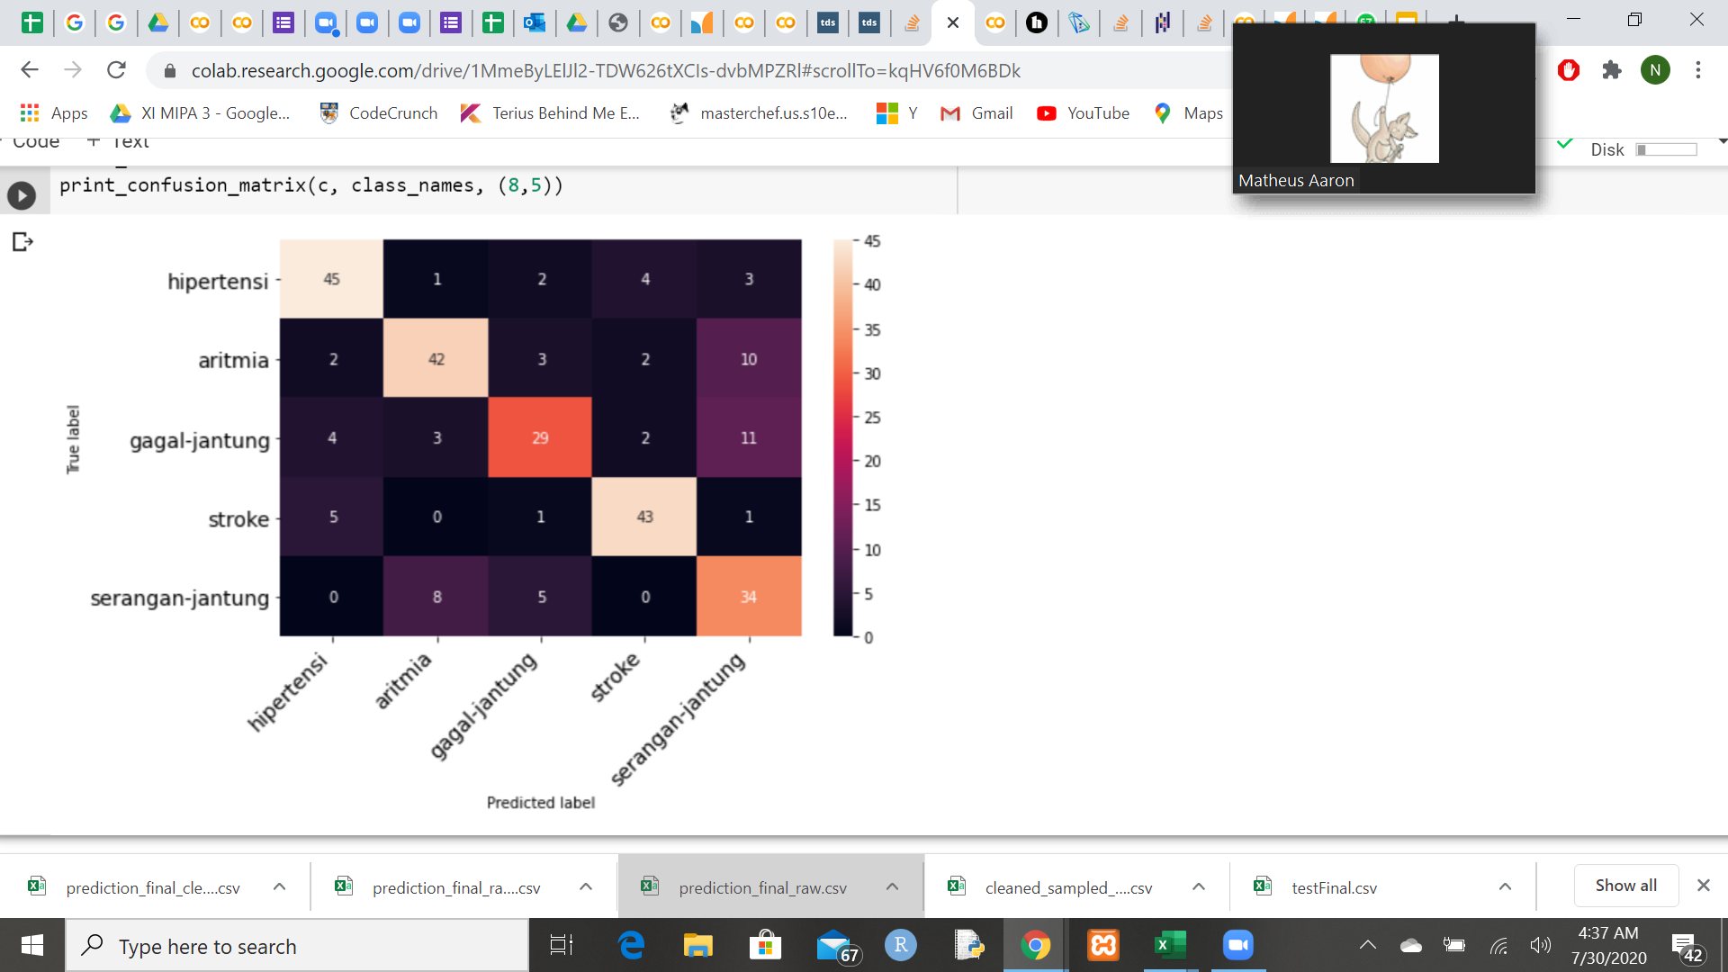
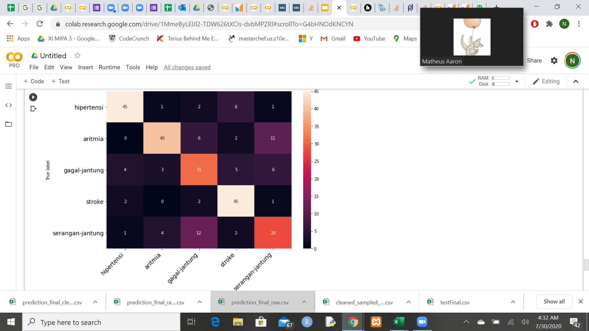
Model Performance
Before Data Cleaning After Data Cleaning

Slide 23
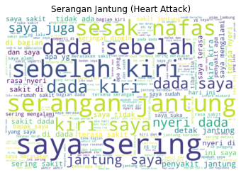
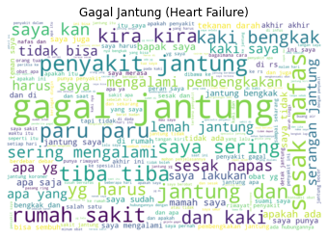

Slide 24
73.07%
FINAL BEST PERFORMANCE
After cleaning the data, we achieved an accuracy on multi-class labelling of 73.07% on the test dataset after training on the raw dataset for 5 epochs.
Recall 74% F1-score 74%

Slide 25



Despite high performance, there are some flaws.
Noisy Data
Some of the user posts are more about general medical enquiry rather than asking for diagnosis.
Wrong Diagnosis
The category of the post might not be the actual diagnosis. Actual diagnosis should be extracted from the answer of the doctor.
Inconclusive Diagnosis
Sometimes, the symptoms may not be clear and may lead to multiple diseases that shares the same symptom.

Slide 26
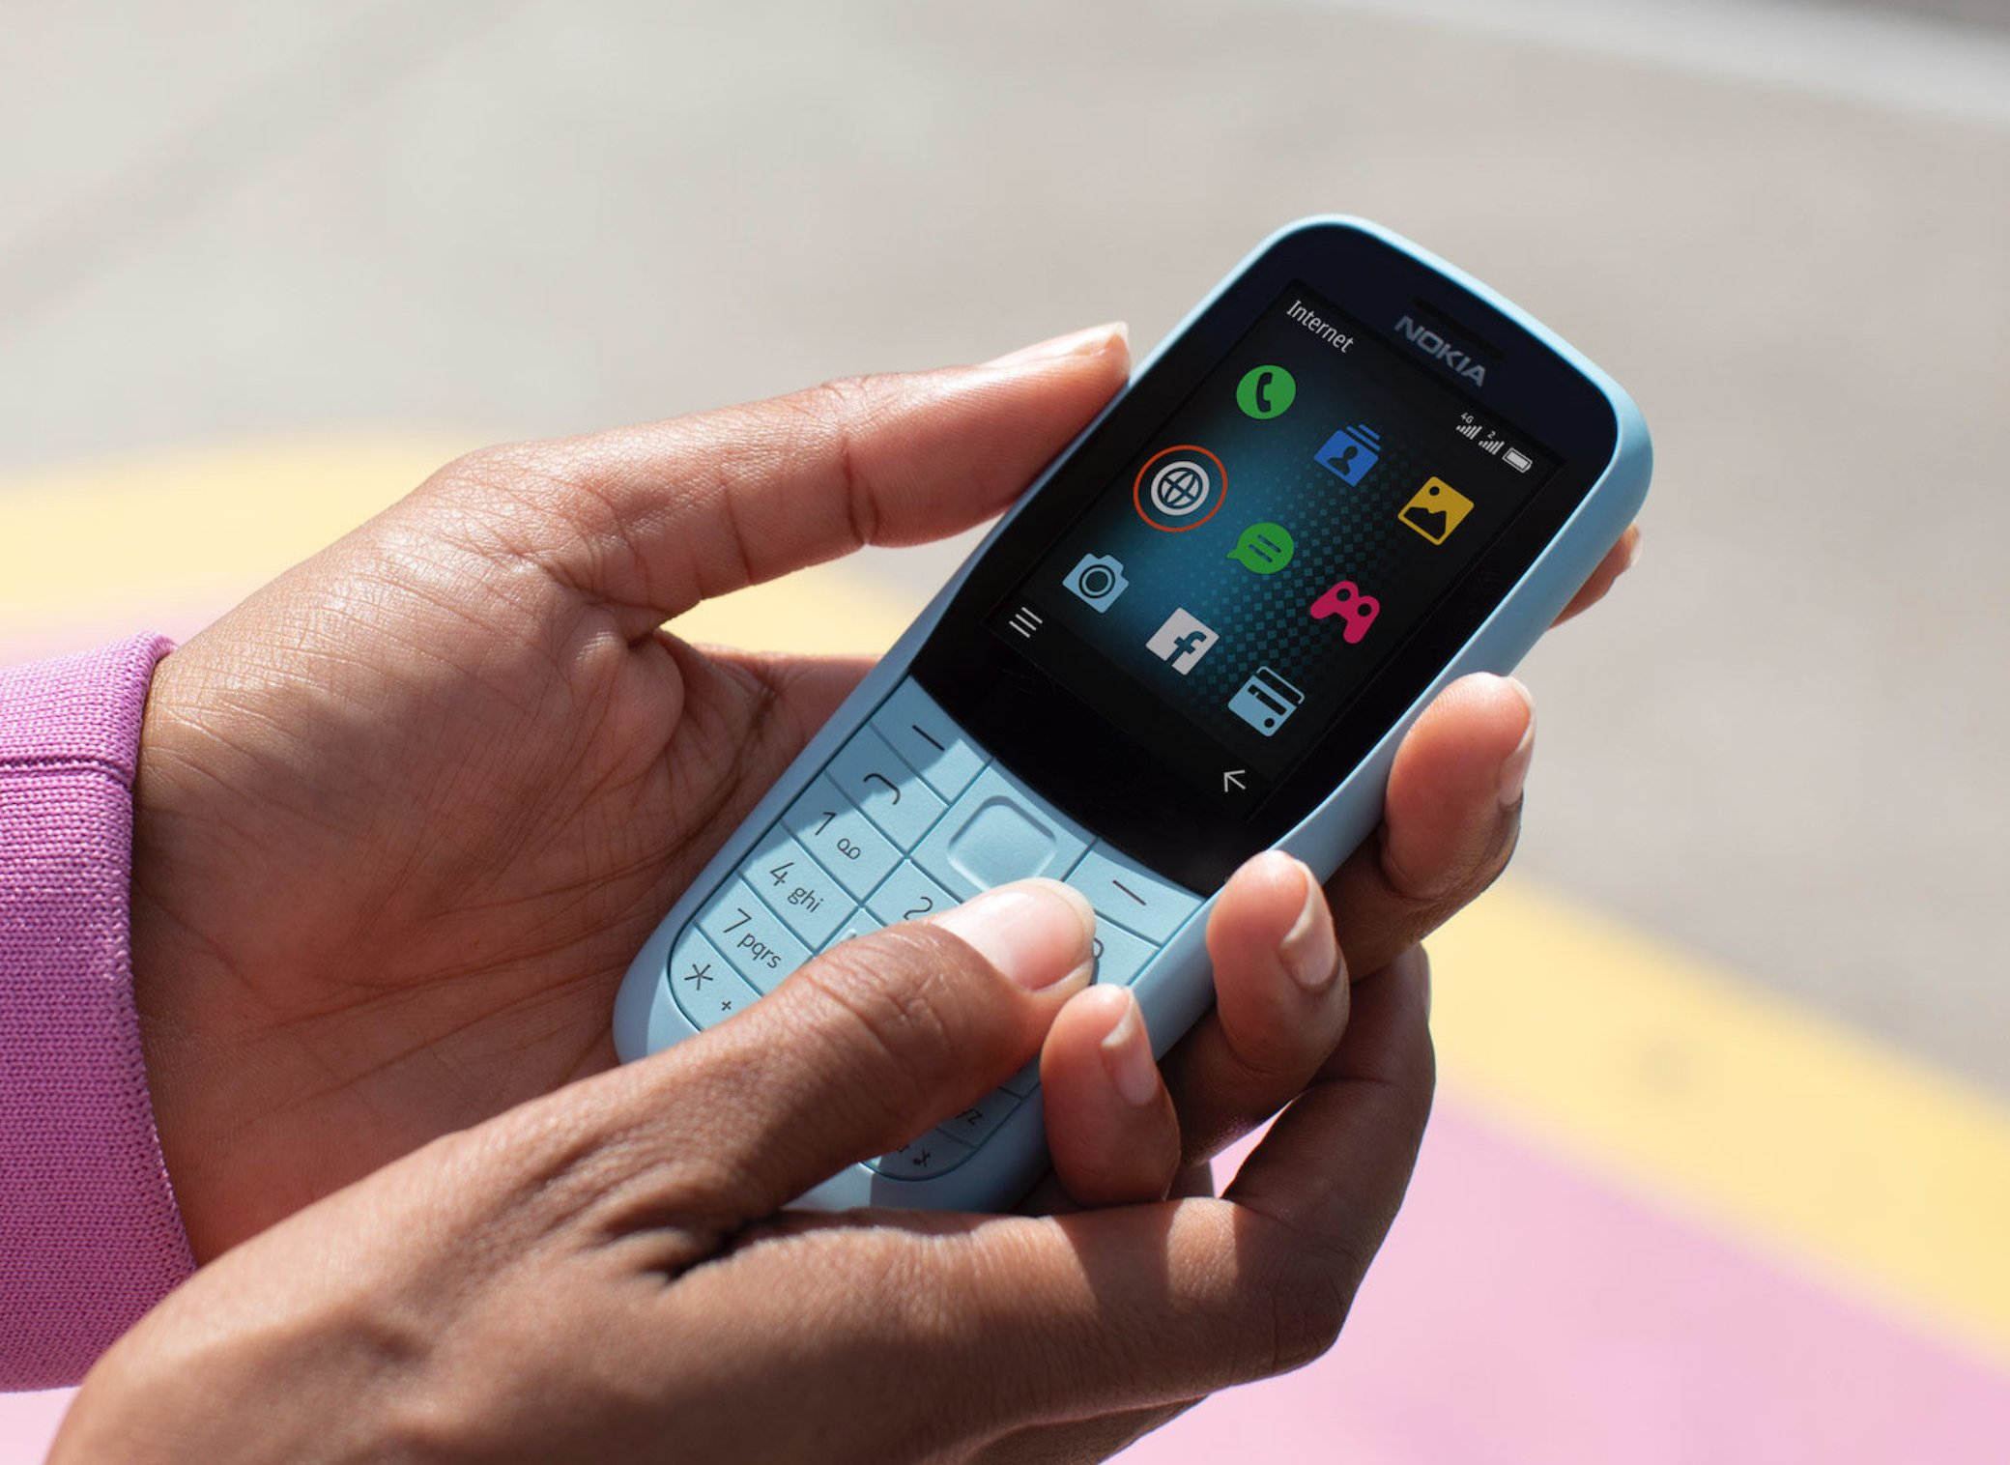
Use case
Call Dr. AI
People with no access to internet and poor access to healthcare providers can call Dr. AI, then the patient’s voice will be transcribed to be diagnosed.
A telemedical platform to get swift diagnosis

Slide 27
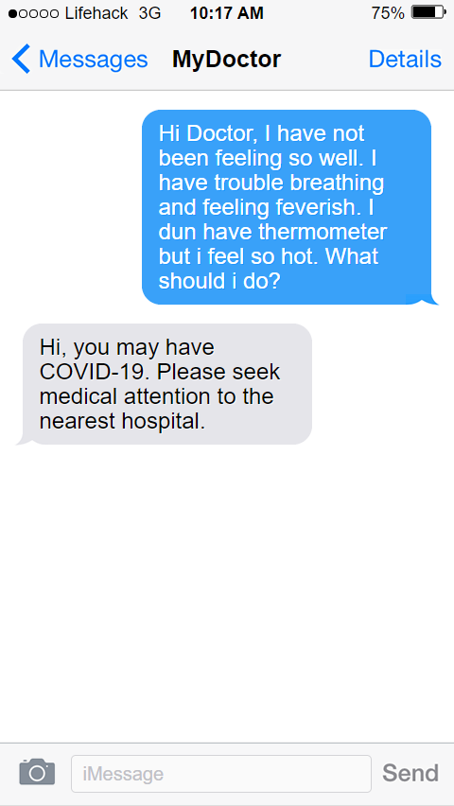
Use case
Text Dr. AI
People with no access to internet and poor access to healthcare providers can text Dr. AI.
A telemedical platform to get swift diagnosis
Notes:
Similar to Call Dr. AI, people can text to receive their diagnosis.

Slide 28
Use case
Government Health Condition Monitoring
Relevant authorities are able to map the medical conditions faced by each area. Geolocation can be obtained from the citizen’s texts and calls.
Health authorities will then be able to allocate resources more efficiently.
A way for Ministries of Health around the world understand health condition of its citizens

Slide 29



Future Iterations
Clean the Text better
and
Feed more Dataset
Explore other pre-trained NLP models
BERT-Malay
XLM-Roberta
Use sliding window to retain more info

Slide 30



Future Iterations
Use Multi-label modelling
Extract Diagnosis from the doctor’s official response
Extend the project to other diseases

Slide 31
Reflection and Conclusion
Notes:
The results from this project may fell short of what we needed, but it certainly shed some hope on a future where healthcare can be more affordable with AI as doctors. This project is certainly a proof of concept that this is possible. This will serve those on the margins better as they have less access to proper healthcare.
As more data is generated every hour on platforms like Alodokter, we believe that one day, we will have an open source AI general doctor that will be able to at least provide a pre-diagnosis to patients and prompt them to visit the nearest healthcare facility. This project will increase the public’s interest in healthcare and we, as a society, will move forward healthier together.

Slide 32
Acknowledgement
We would like to thank a friend of ours, Ms Gabriella Jessica SUJATA, who is currently pursuing a Bachelor in Medicine, for aiding our project by providing our team the understanding of the current medical landscape in Indonesia and the world.
We wish her the very best of lucks in pursuing her dream of becoming a doctor.

Slide 33
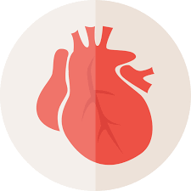
Problem: Cardiovascular Diseases (CVD) in Indonesia
Stroke and ischemic heart disease are two most common causes of death in Indonesia both in 2007 and 2017 (healthdata.org)
Less than 25% of primary health care centres offered CVD risk stratification (risk assessment) in 2017 (WHO)
Less than 50% of health care facilities utilised CVD guidelines

